Slide 1
Pipelines
Makes to snakes
Notes:
Tim Boyarski
Co-op Term
Makes to Snakes
A loosely-couple factory

Slide 2
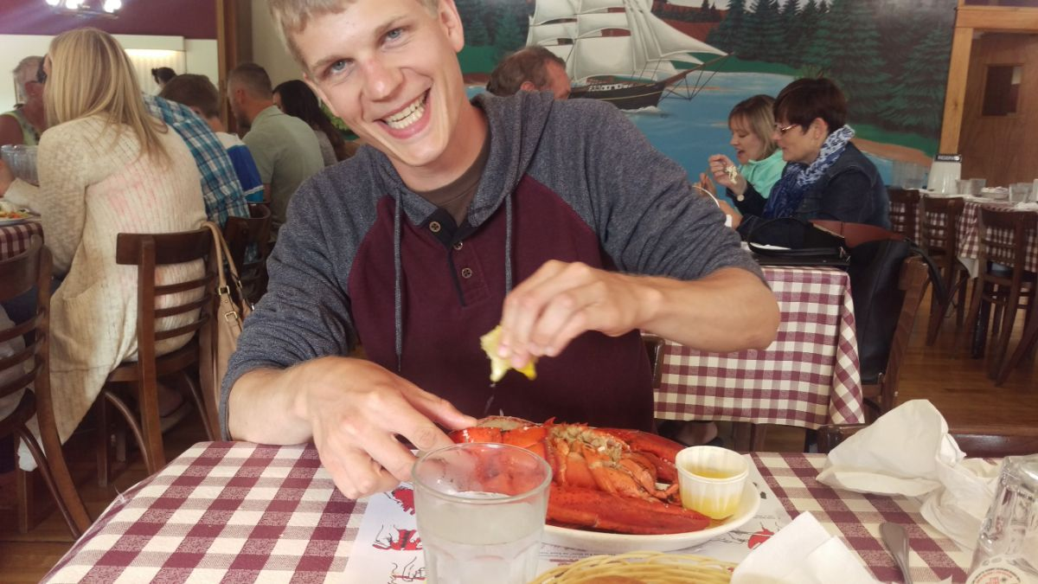
Notes:
Summer vacation travel picture homage
In PEI, I drove 15,000km before I got to that meal.
Rather unsatisfying meal at 12,000km in Cape Breton.
Im really excited to be here, especially talking about computers.
Thank you Dr Steidl, Fong, Lauren, Stacy, Fariha, and everyone else in the department. This has been great experience.

Slide 3

Bsc: Biology
Background
2008
University of Victoria
Major: Biology
Minor: Microbiology
Co-operative Education
Diploma: cst
2016
British Columbia Institute of Technology
Computer Systems Technology
Co-operative Education
Notes:
2008-2013 ~ Some computer science electives
2016 I started began an education focused on programming and computer technology.
I applied for the position in Sept, and started in January.
I am also working part-time for BCIT, and I am taking a part-time course there as well.
Part-time course has been very relevant to what I have been tasked with accomplishing for the group.

Slide 4
http://sce2.umkc.edu/BIT/burrise/pl/design/

Slide 5
PIPELINE
Apply
Space
Travel
Learn
Train
OPTIONS
Space-X
Circuits
Florida
Moon
Engineer
Biology
Calif.
NASA
Doctor
Physics
ISS
ASSEMBLE
NASA
Florida
ISS
Engineer
Circuits
Notes:
A pull based request, we keep asking ourselves, what do I need to do this?
Christian says he wants me to go to space, all expense paid.
He goes “I doctored the system in your favour, it’s do-able, I don’t have time to tell you exactly how, I know you’ll figure it out”

Slide 6
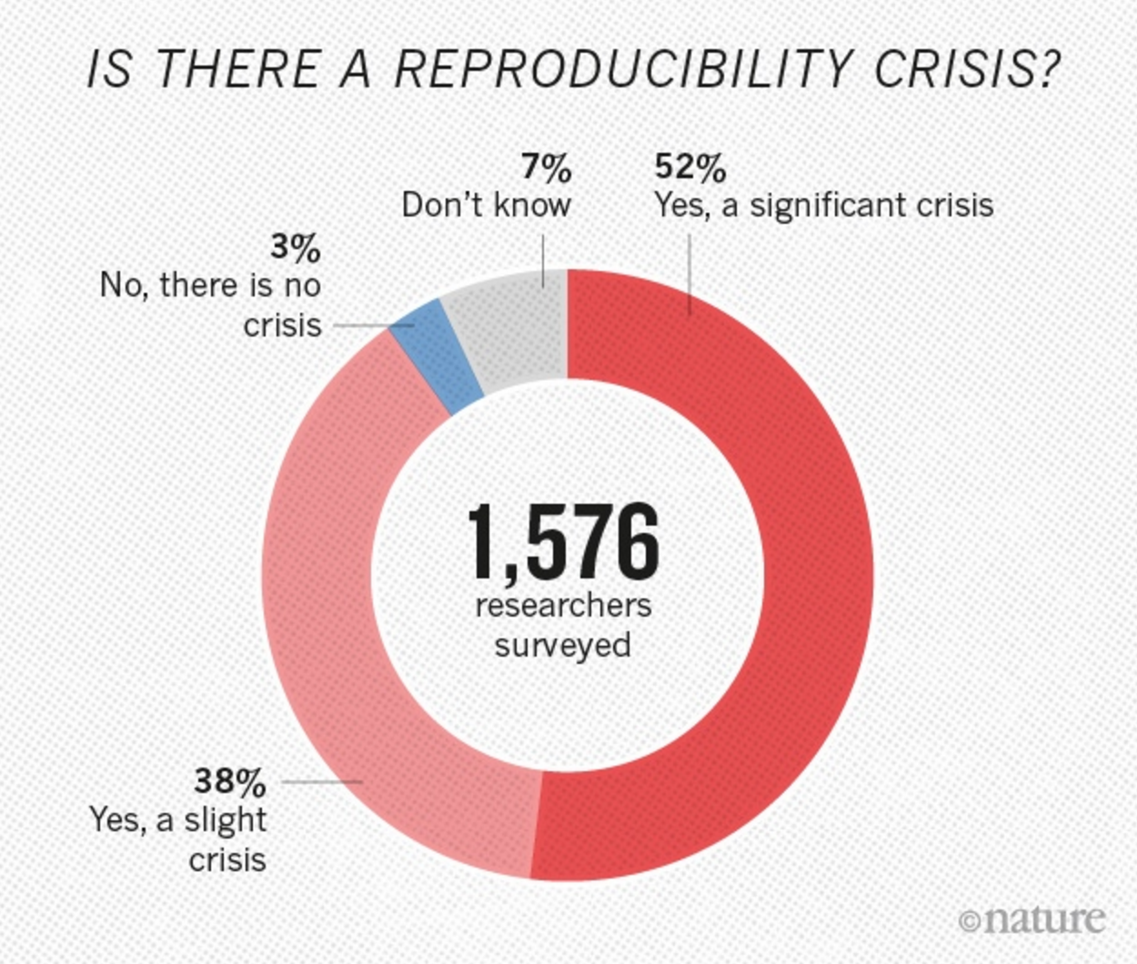
The problem
Processing Infrastructure
Increase efficiency
Increase reproducibility
Better UX
Code clarity
Modularity
Cohesion & decoupling
High-Level Language
http://www.nature.com/news/1-500-scientists-lift-the-lid-on-reproducibility-1.19970
Notes:
Approached with these problems
Efficiency, we all know.
Reproducibility, top right diagram ~ 2016-May
UX, user experience… the interaction with the system
Modularity, structured variation
Cohesion and decoupling,
High-Level Language, the power and clarity associated with a modern language

Slide 7
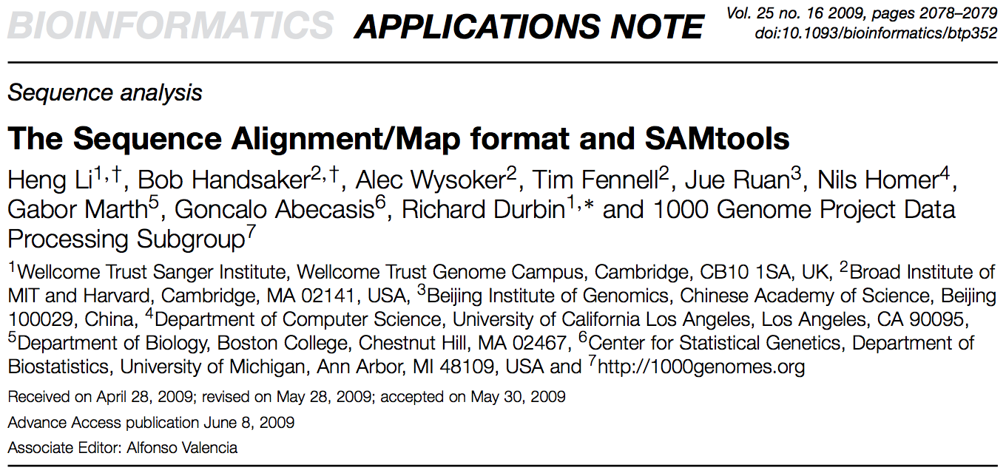
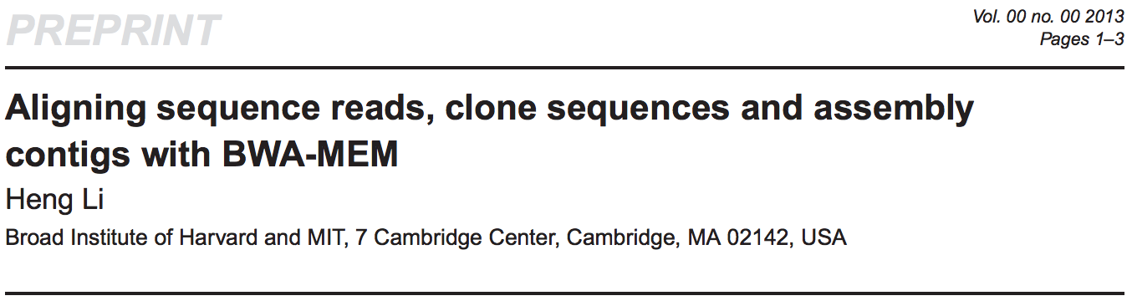
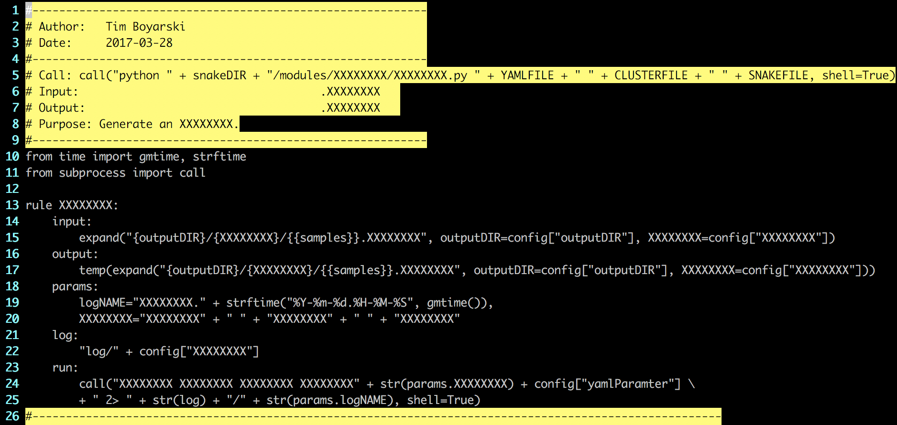
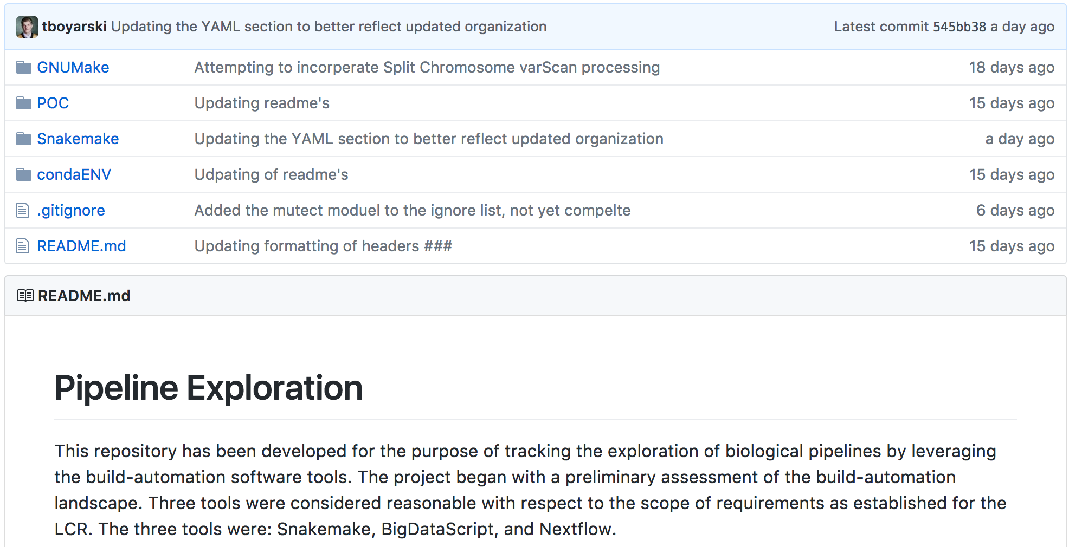
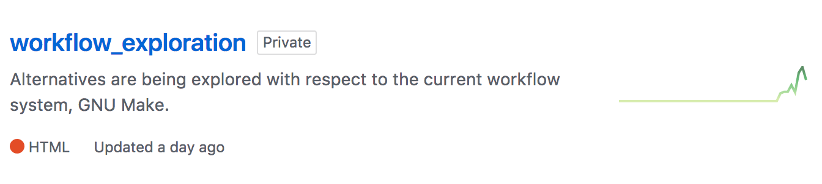
WORK overview
1
Software
2
Languages
3
Code
Notes:
Busy slides, busy time.
Three topics of my presentation.
Will try to provide prospective and insight in each of these categories.
The Samtools publication has been cited 11,000 times.
You need about 13,000 citations to be listed under the top 100 most cited papers in nature.
Far from the days of copying and pasting sequences into a BLAST search.

Slide 8
Learn Software
JANUARY
1
2
Preprocessing Tools ~ Samtools, BioBamBam
Analysis Tools ~ varScan, MuTect, Platypus
Presentation Tools ~ VCF Viewer, R Studio
Coordinate into a Pipeline!
3
4
Notes:
Preprocessing – Versioning of software, what the GSC uses is not what we use (think Hurricane Katrina ~ 2005), so we have to spend some time “re-calibrating” the data
Analysis Tools – Bulk of the computational processing, variant callers, mutation callers,
Presentation Tools – Ability to view the data
A series of events
Understanding of the working landscape

Slide 9
Evaluate Languages
FEBRUARY
<2010
1
NGS
Step-Wise: Bash/UNIX Systems
BDS ~ Lacking Conda, community
Nextflow ~ Niche, excessive, cumbersome
Snakemake ~ Portable, scalable, reliable
2010 - Present
2
3
4
Notes:
Start over on the left. The penguin, represents the system we still currently work in, UNIX.
Make, then GNU Make was developed to automate many of the things being done within the system, it brought forth scripted process automation.
This was done by providing use with a dependency operator. It’s the power of not starting something new, until something else is finished.
Until recently this has been sufficient, thus we started investigating other langugaes.
BDS – Lacks direct Conda integration; Small supporting community
Written by Pablo Cingaloni, creator of snpEff, software program cited 1400+, used in Nature, Science..
Nextflow – Too niche; Too large of learning curve with paradigm of talk; UI overhead
Barcelona Spain – Center for Genomic Regulation, Team operates it.
Snakemake – porridge was just right.
Johannes Koester, Myles Brown, Division of Molecular and Cellular Oncology, Department of Medical Oncology, Dana-Farber Cancer Institute, Harvard Medical School
Kind of like children's literature, the story of Goldilocks and the Three Bears, right?

Slide 10
FEBRUARY
1
2
3
4
Notes:
A more metaphoric example. Consider the utilities, accessories, power, and complexity of each vehicle.
We used to walk, and then we built a motor. It was simple, but it’s been great.
It’s starting to show it’s age, we need an updated version.
Mini Coup - It rain’s too much in Vancouver, convertible isn’t an option.
Abrams Tank - Laser guided SNPs, heat-seeking INDEL detection. A lot of cool technology in the lab, night vision, maybe not applicable…
If OJ has taught us anything, it’s important to make sure the glove fits the job.

Slide 11
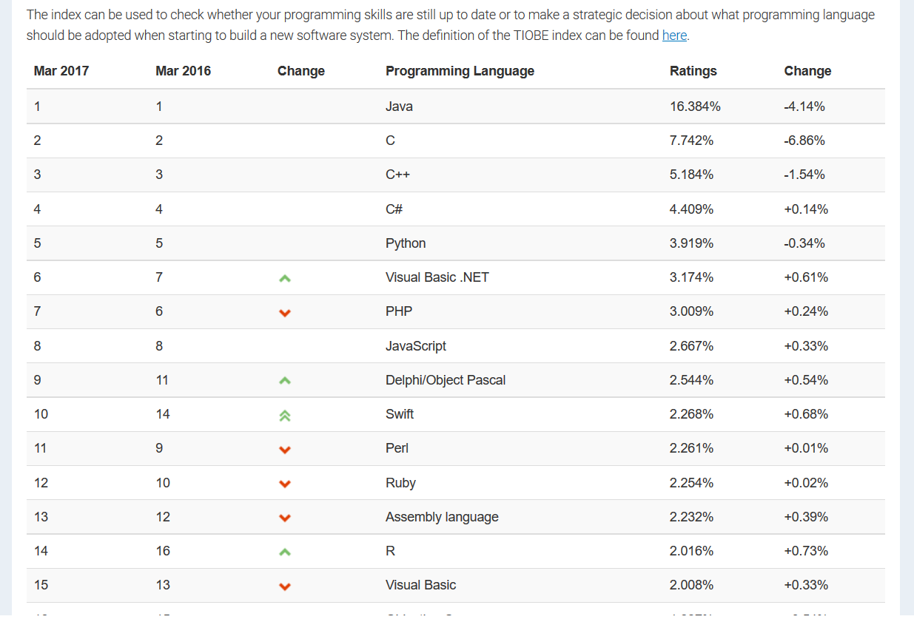
MARCH
https://www.tiobe.com/tiobe-index/
Notes:
Perspective on languages

Slide 12
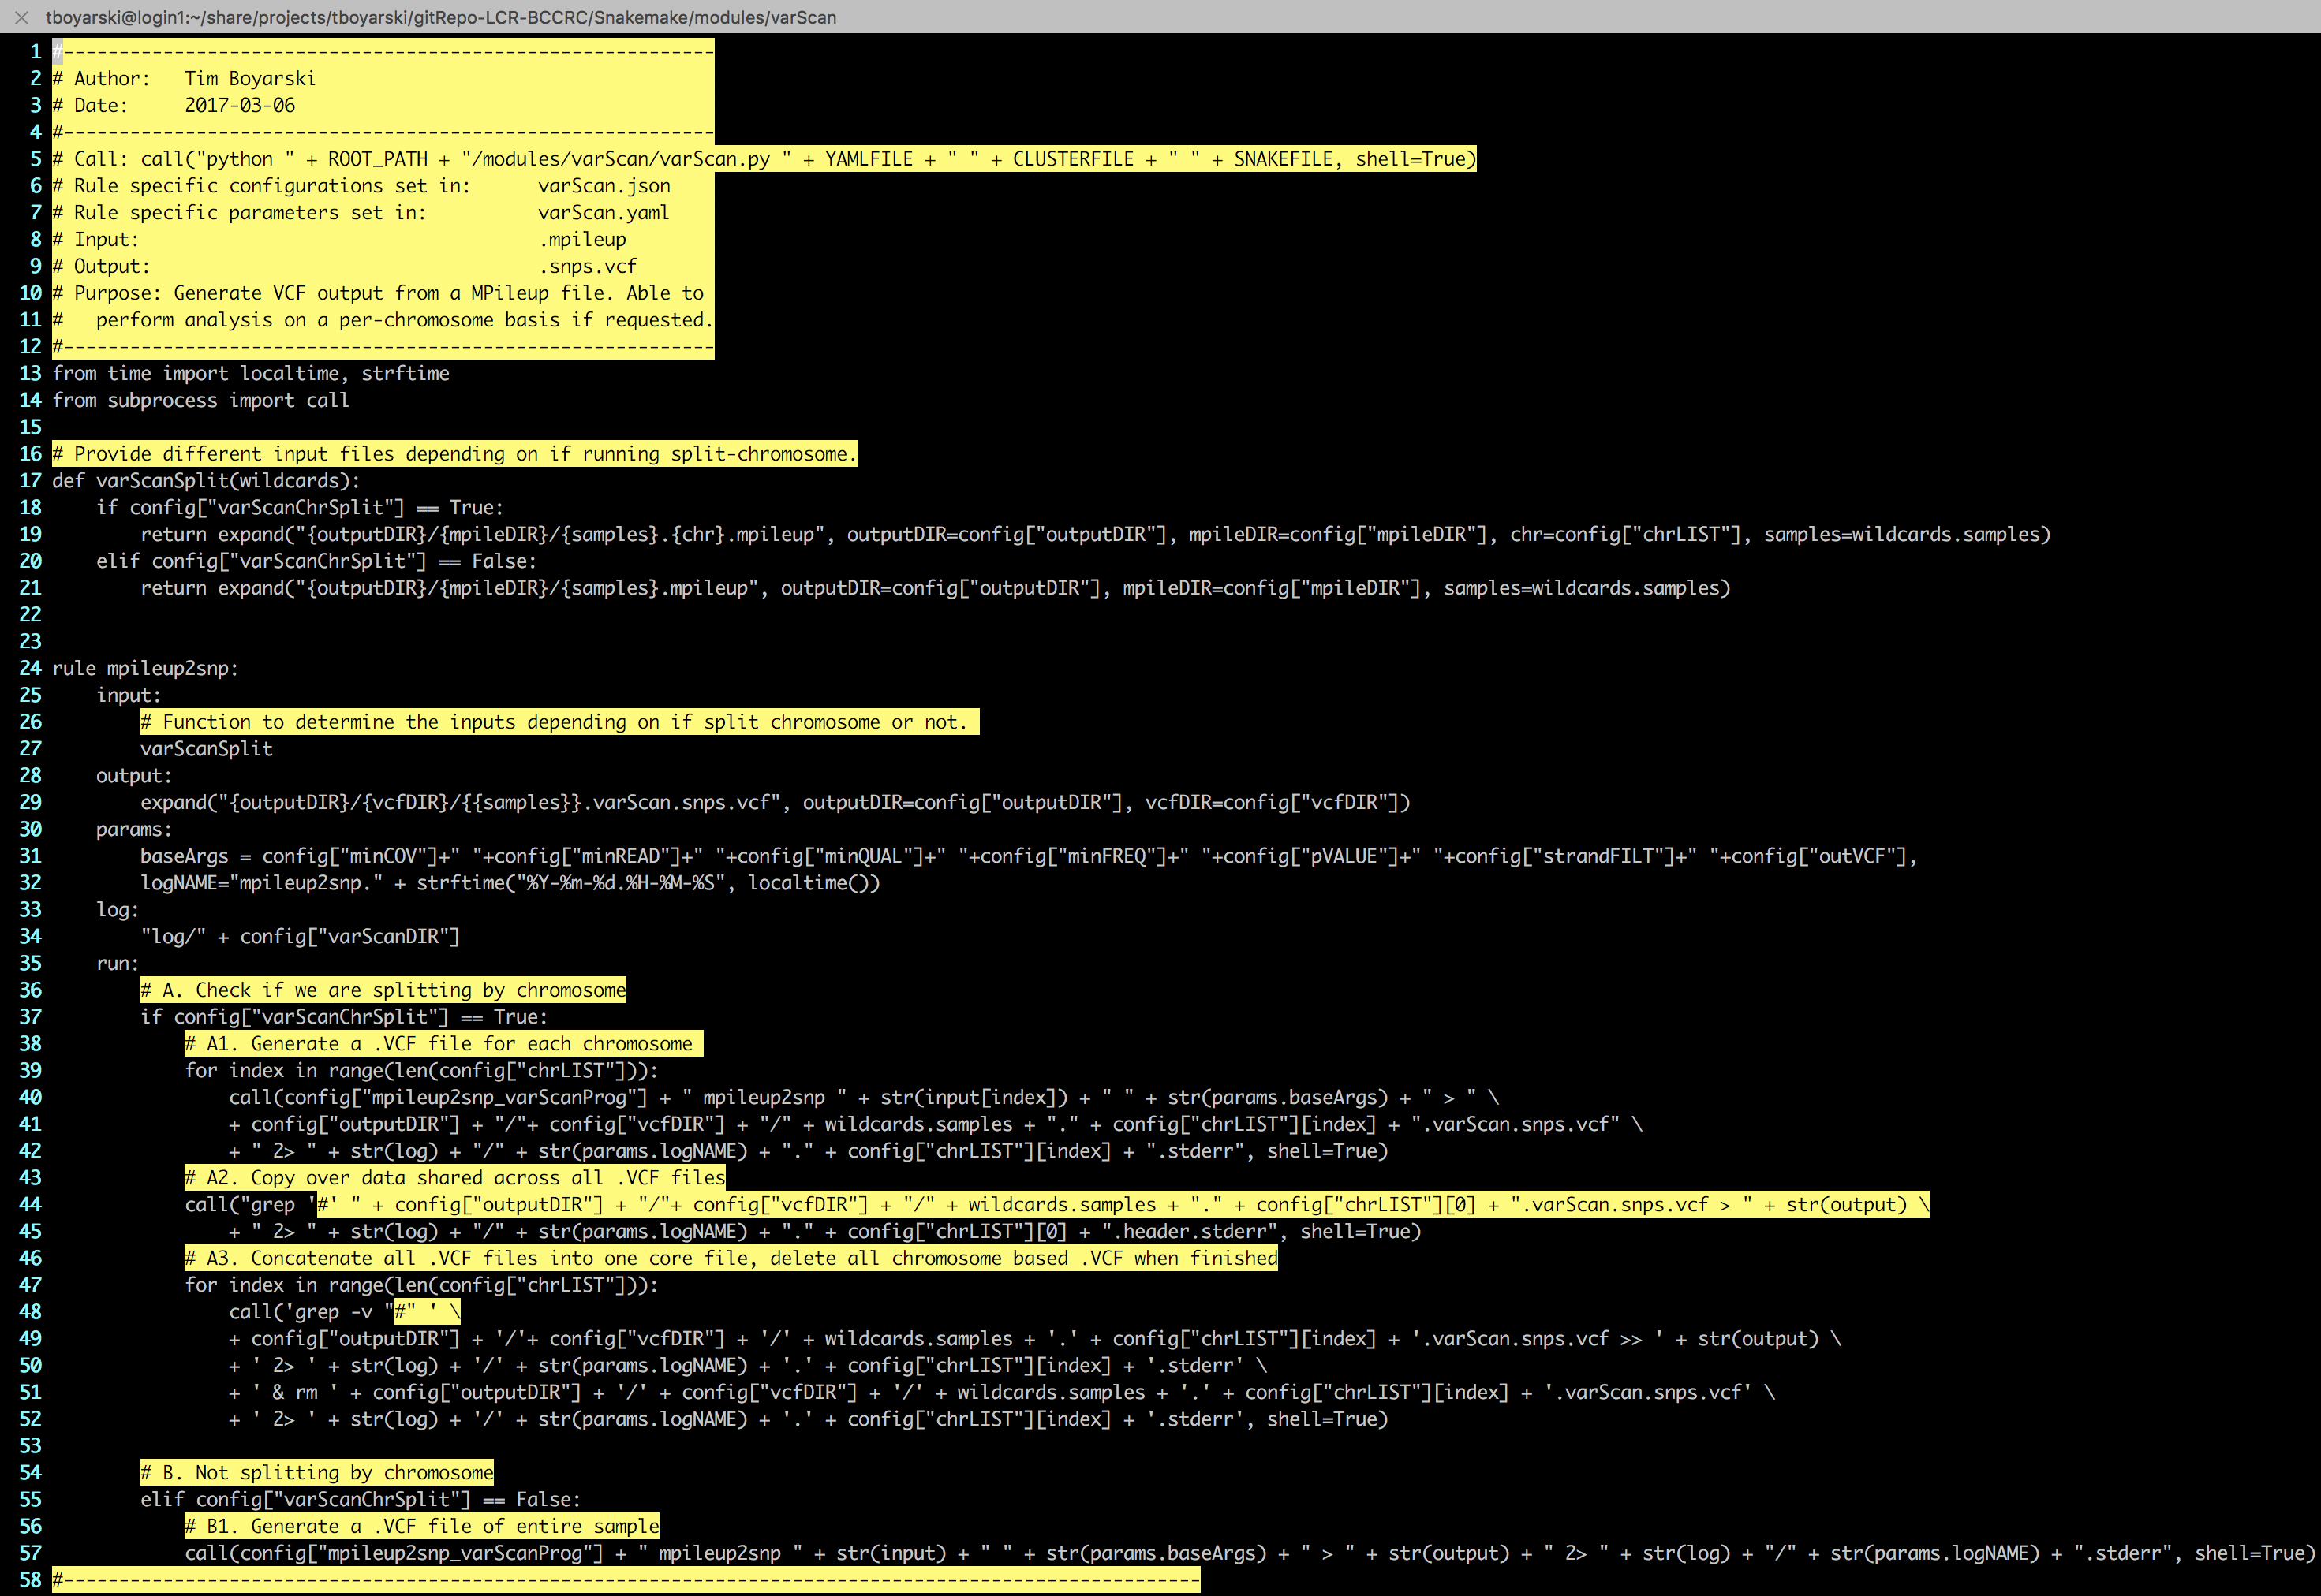
Develop Code
MARCH
Modularity
Cohesion and decoupling
High-Level Languages
Notes:
Then began the coding
An example of some of the code I have produced.
Lets talk about how I got to where I am now.

Slide 13
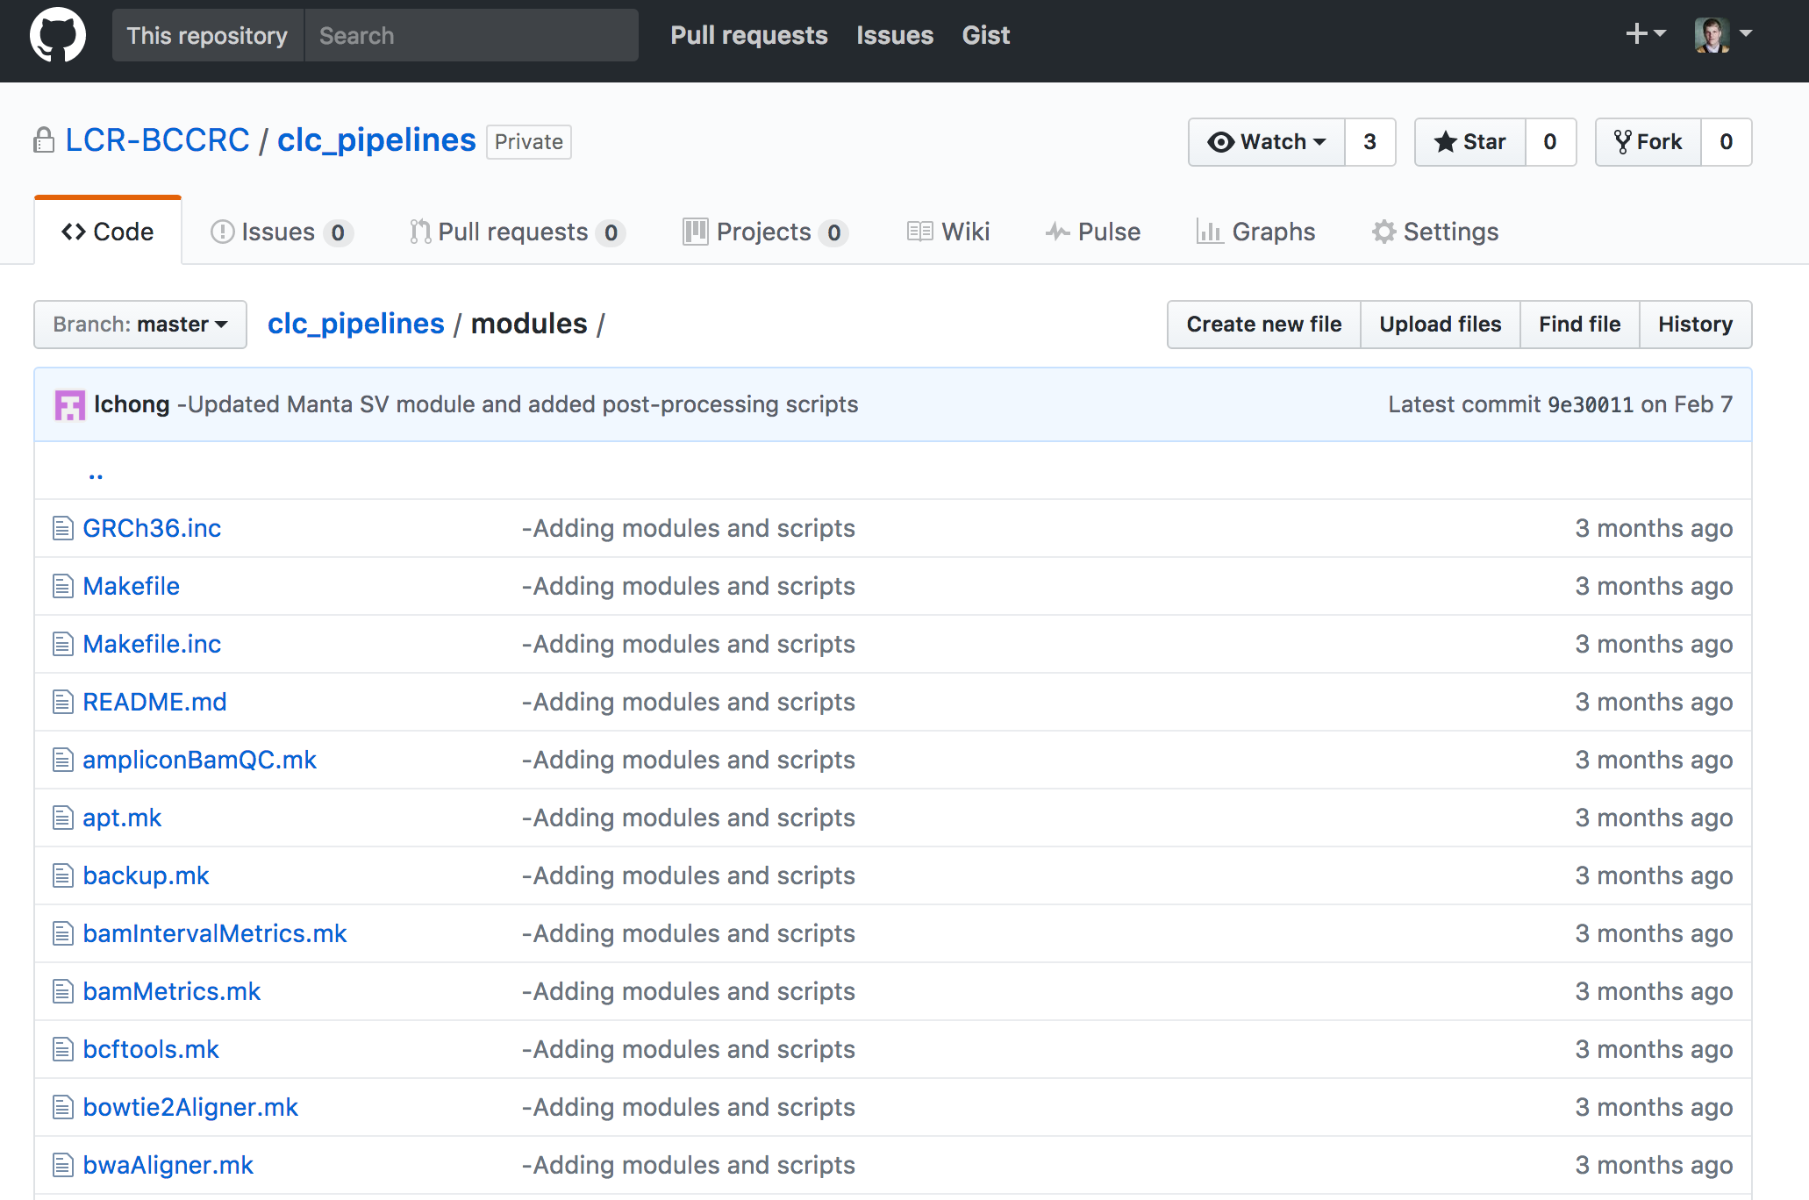
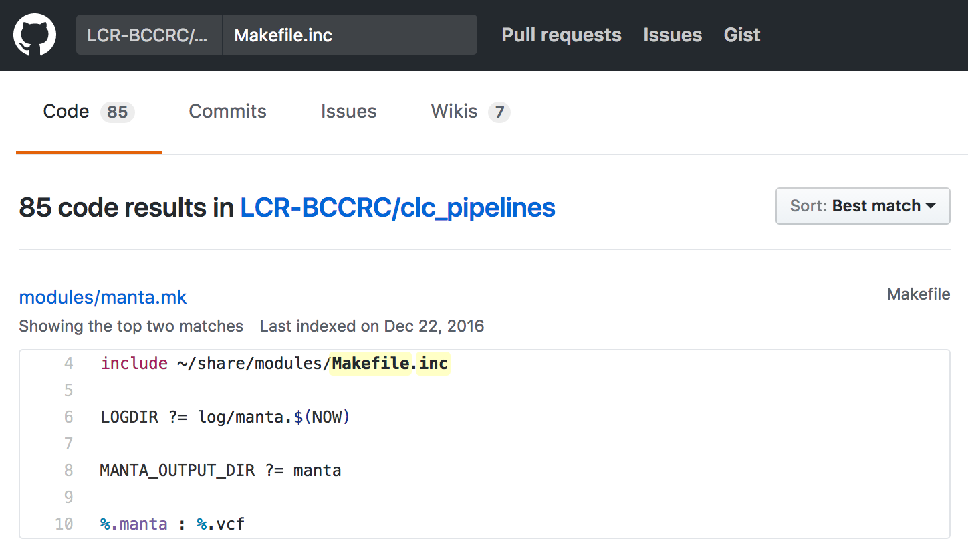
Notes:
Has to give the same message to everyone, no adaptability
If I went to Christian and said “I processed a sample biopsy of a rare **something someone very specifically does**
Everything is organized around this single file, cannot be versioned

Slide 14
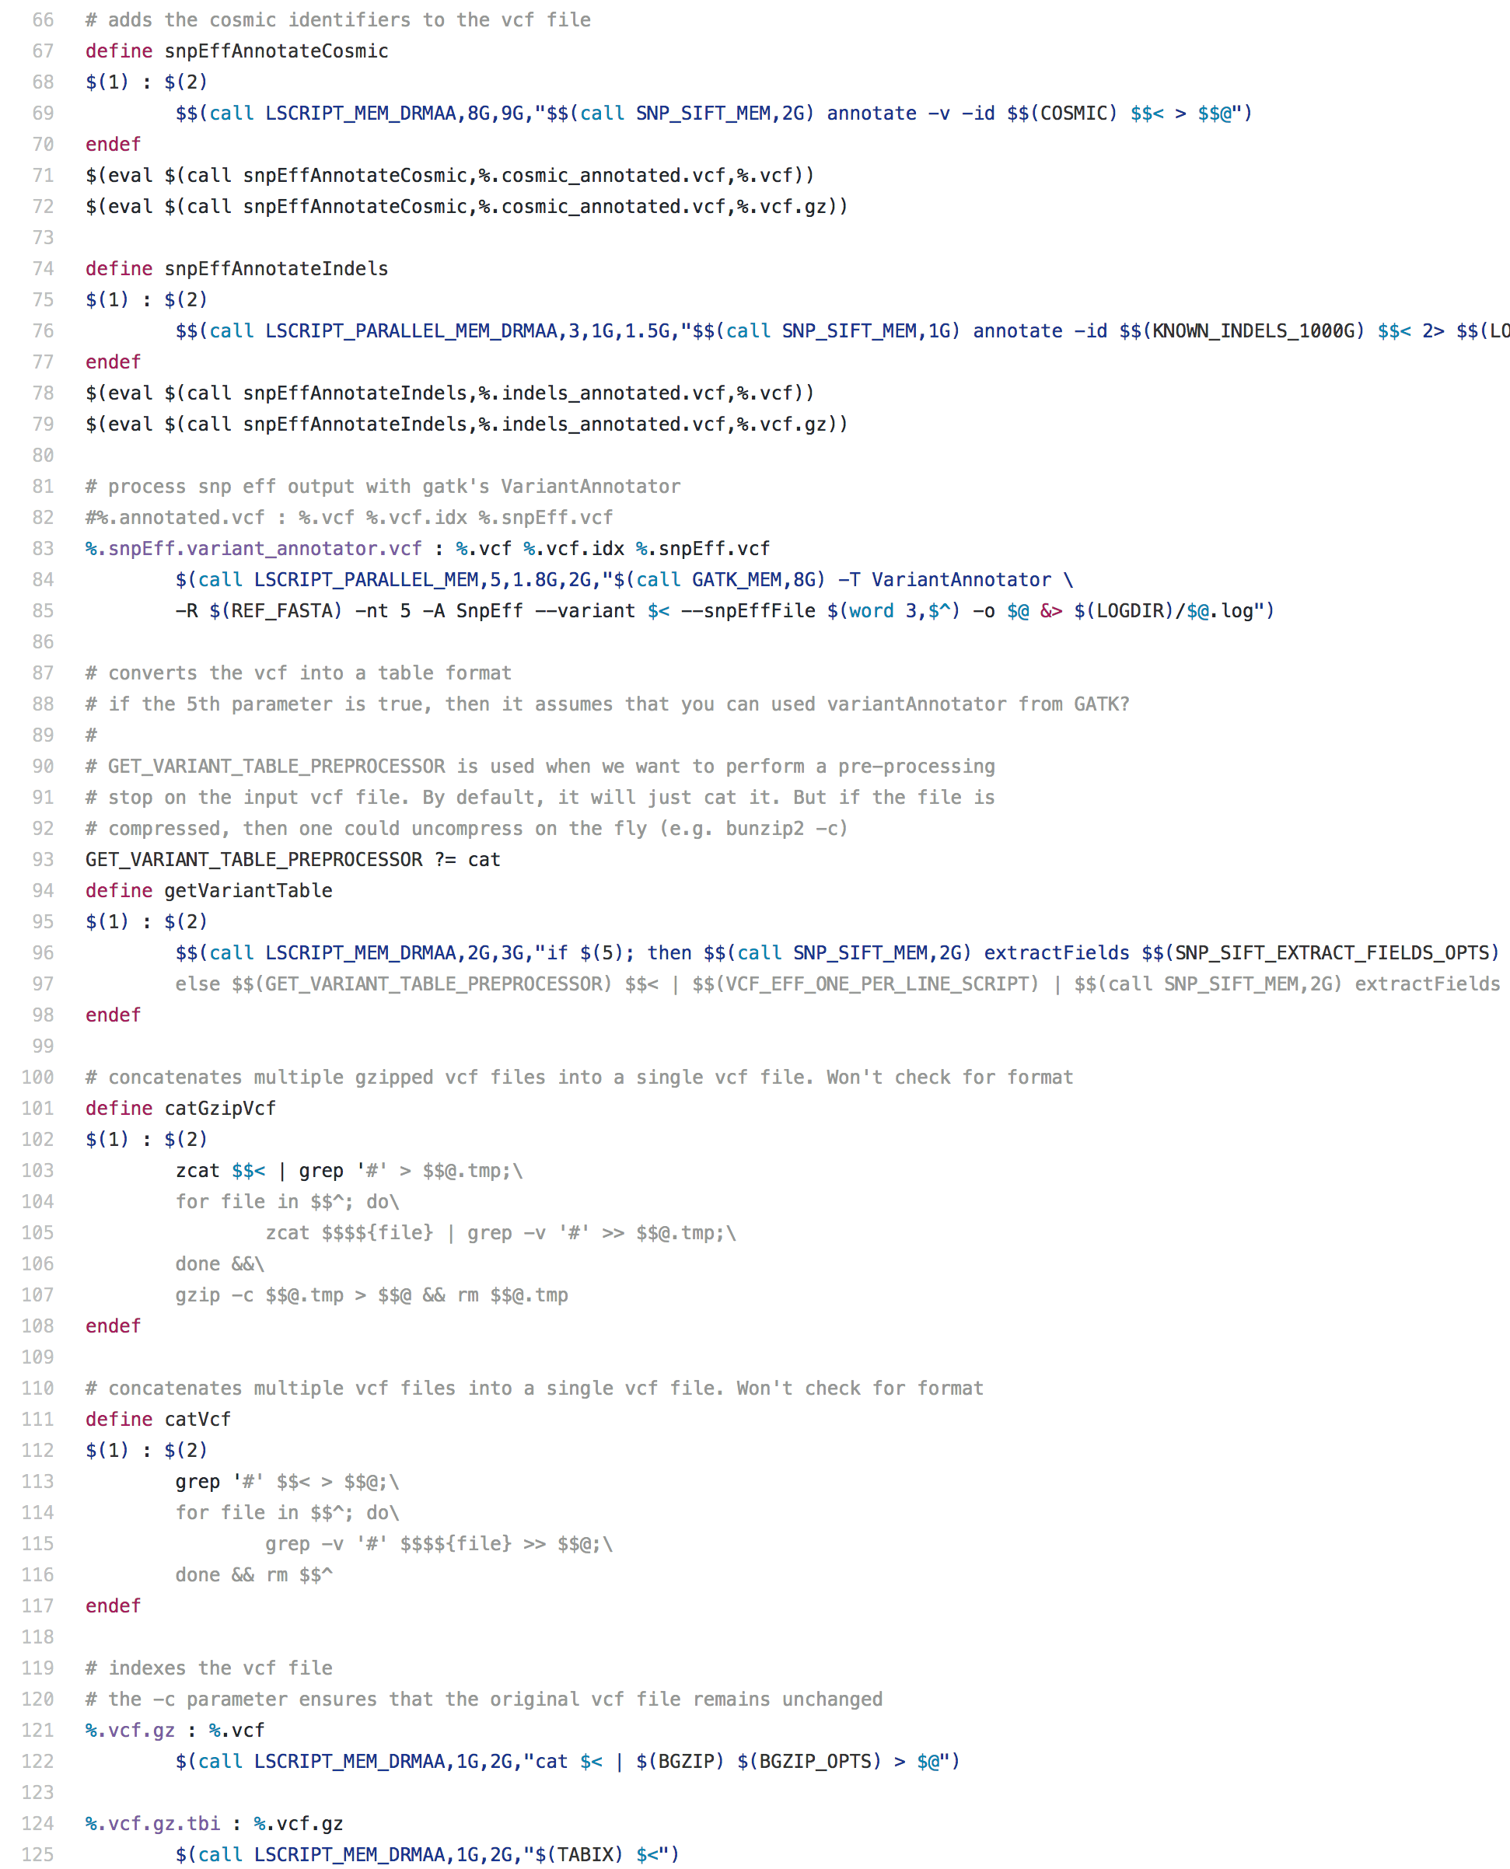
MARCH
initially…
←…… Standard Screen Width …… →

Slide 15
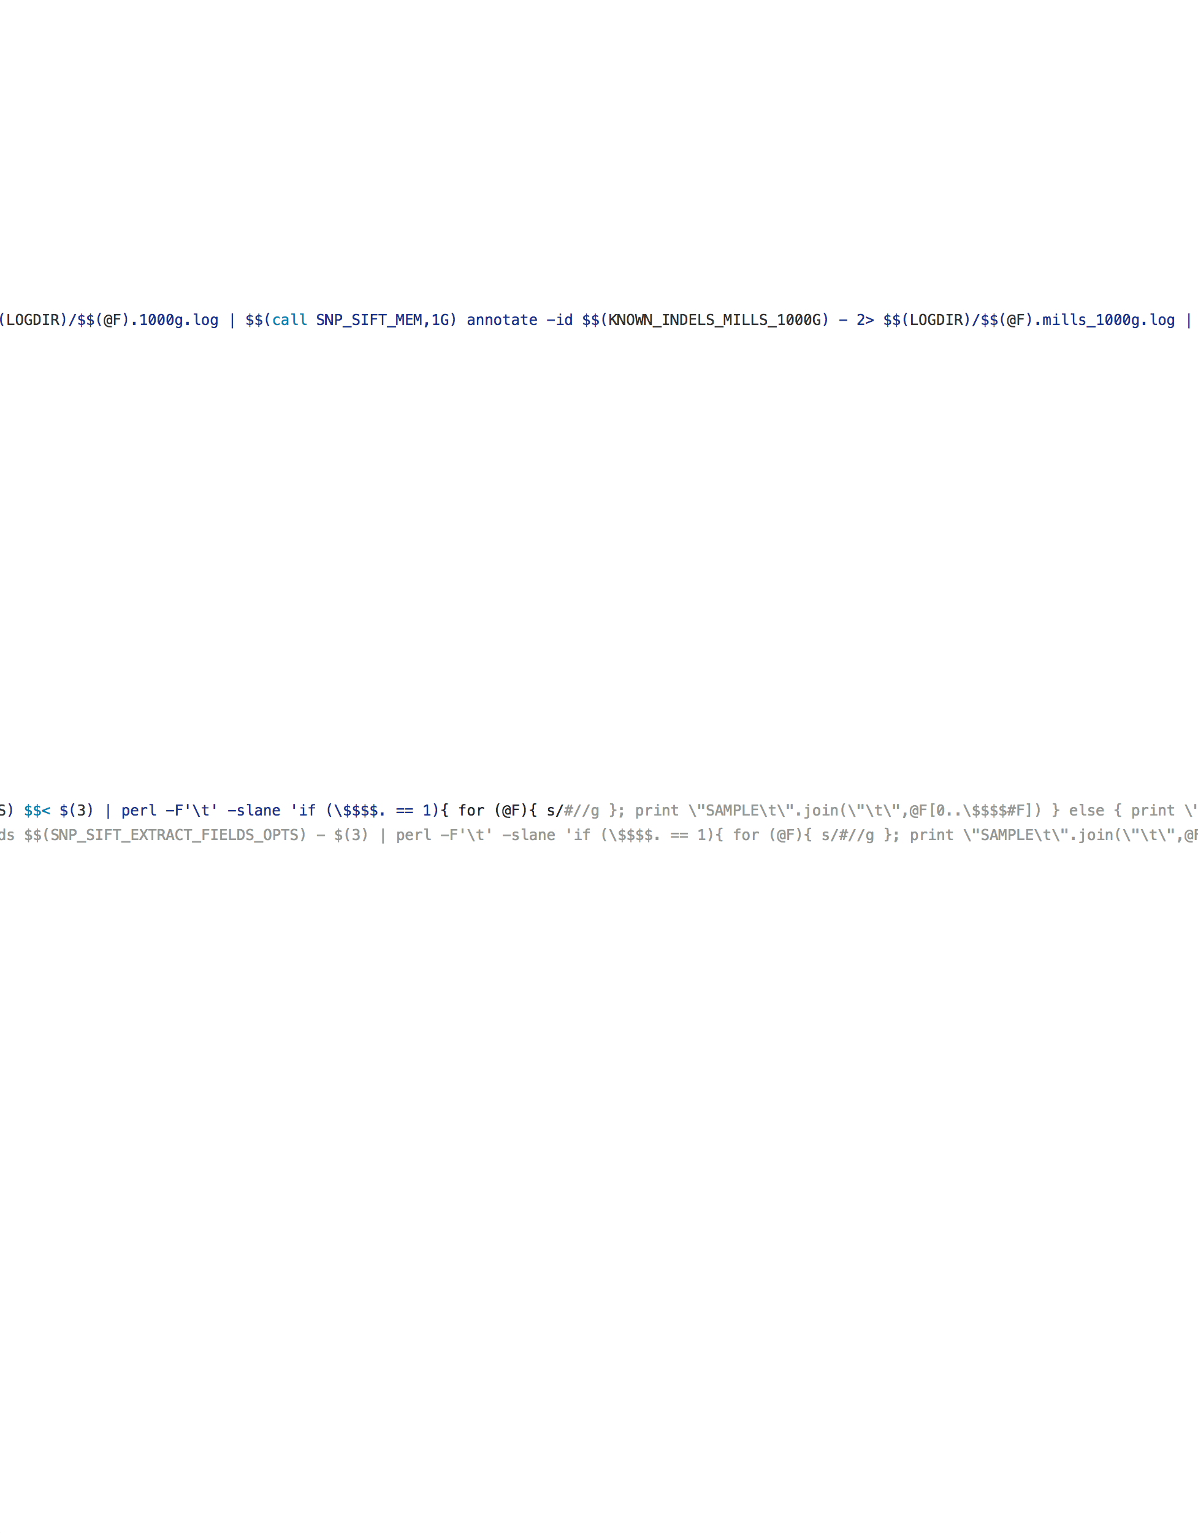
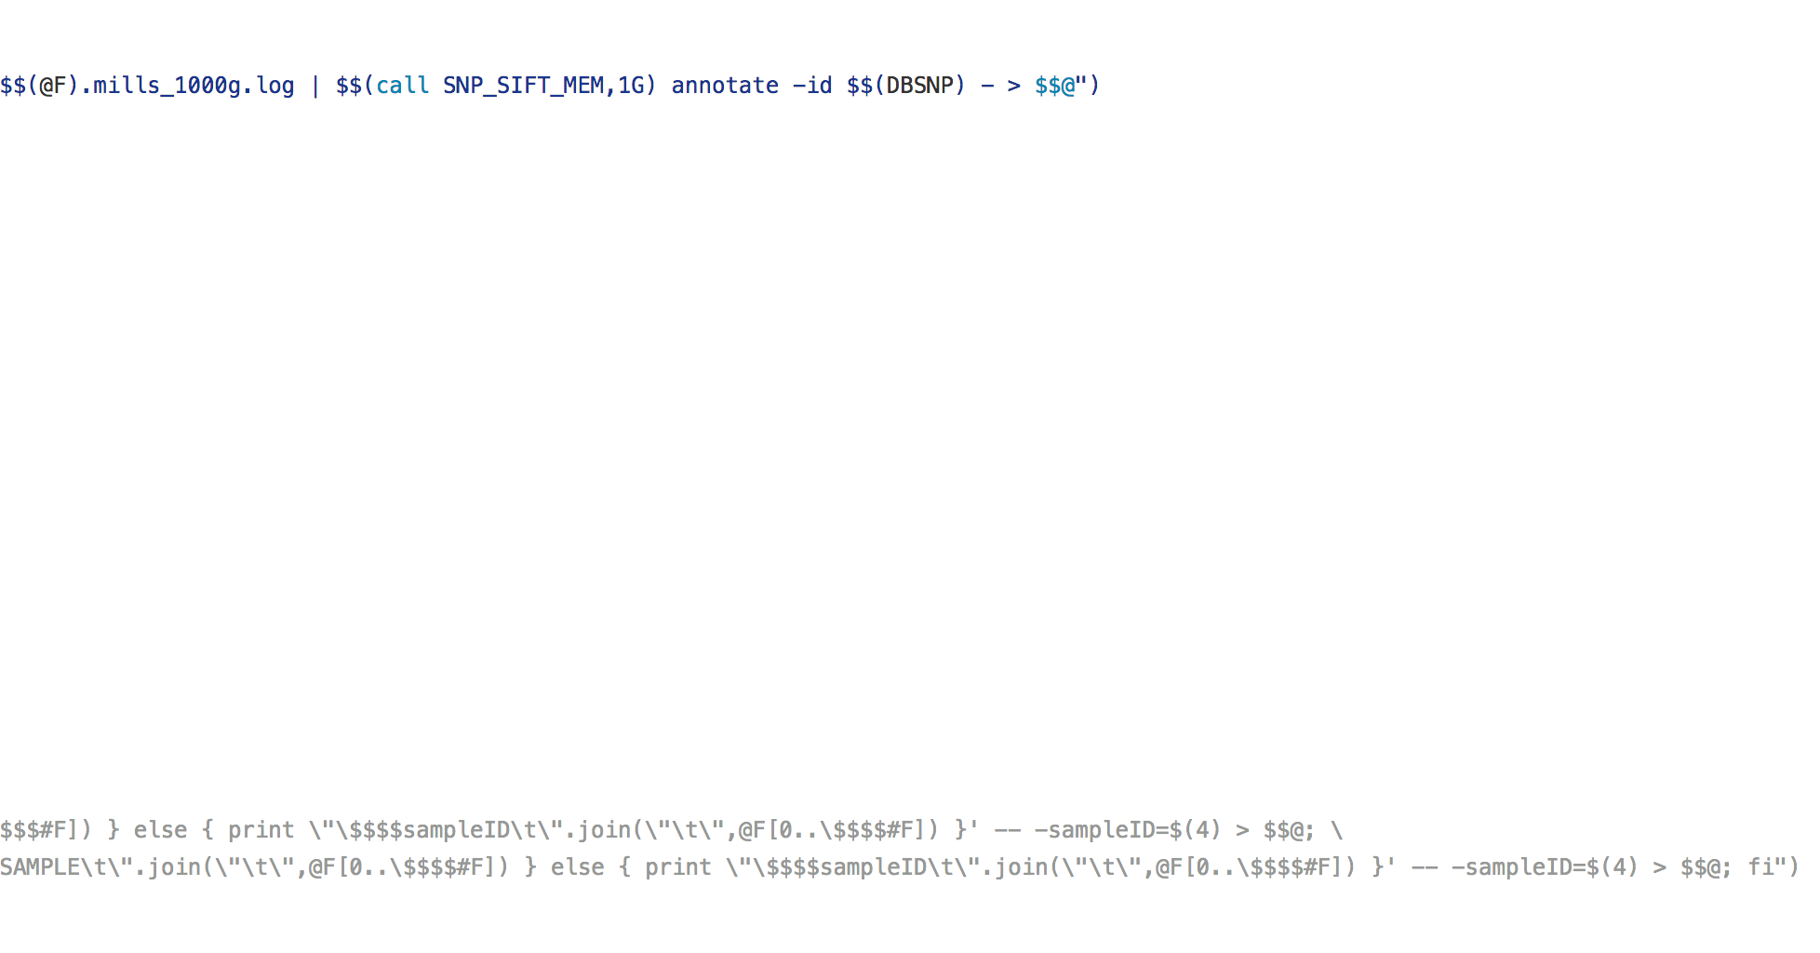
MARCH
When actually…
←…… Standard Screen Width …… →

Slide 16
MARCH
perspective…
80
100
150
DANGER ZONE ** DANGER ZONE ** DANGER ZONE ** DANGER ZONE **
120
200
300
←…… Standard Screen Width …… →

Slide 17
MARCH
As a metaphor…
80
100
150
DANGER ZONE ** DANGER ZONE ** DANGER ZONE ** DANGER ZONE **
120
200
300
Notes:
Metaphorical equivalent.
Technically, there are situations where you can get away with it. On a whole just don’t.

Slide 18
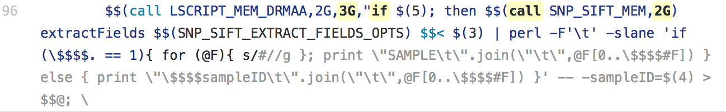
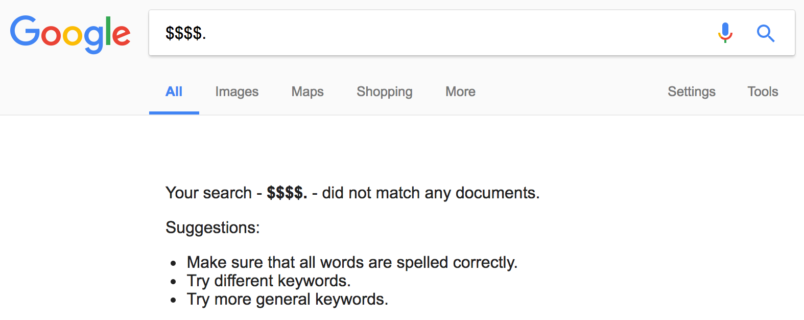
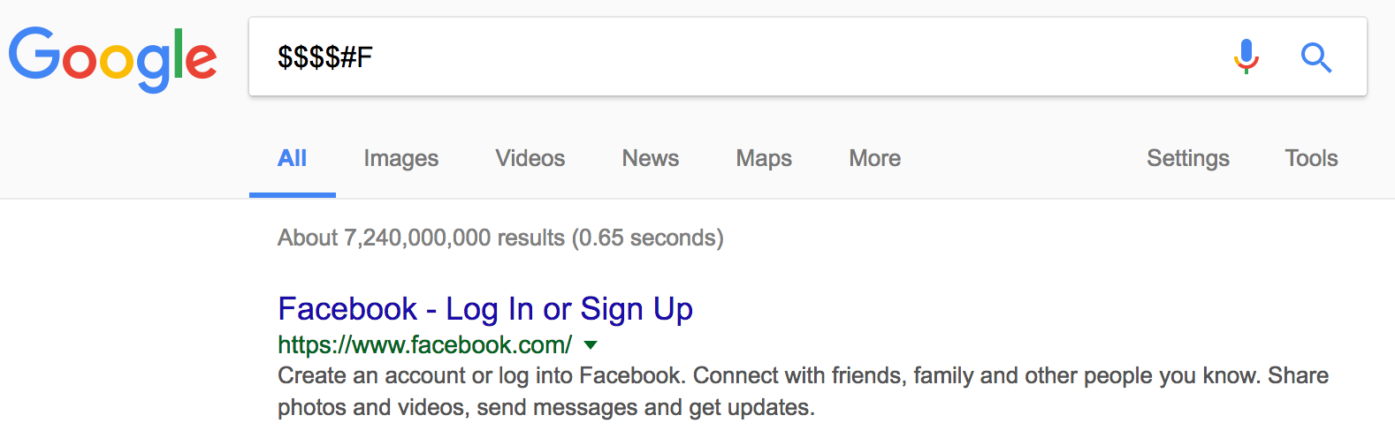
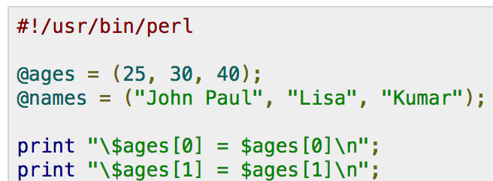
Perl
Make
Bash
Hard
to
Google
Hard
to
Identify
Perl
Make
Notes:
Multiple languages
Difficult to determine which symbols comprise which languages.
And even to determine operator precedence.

Slide 19
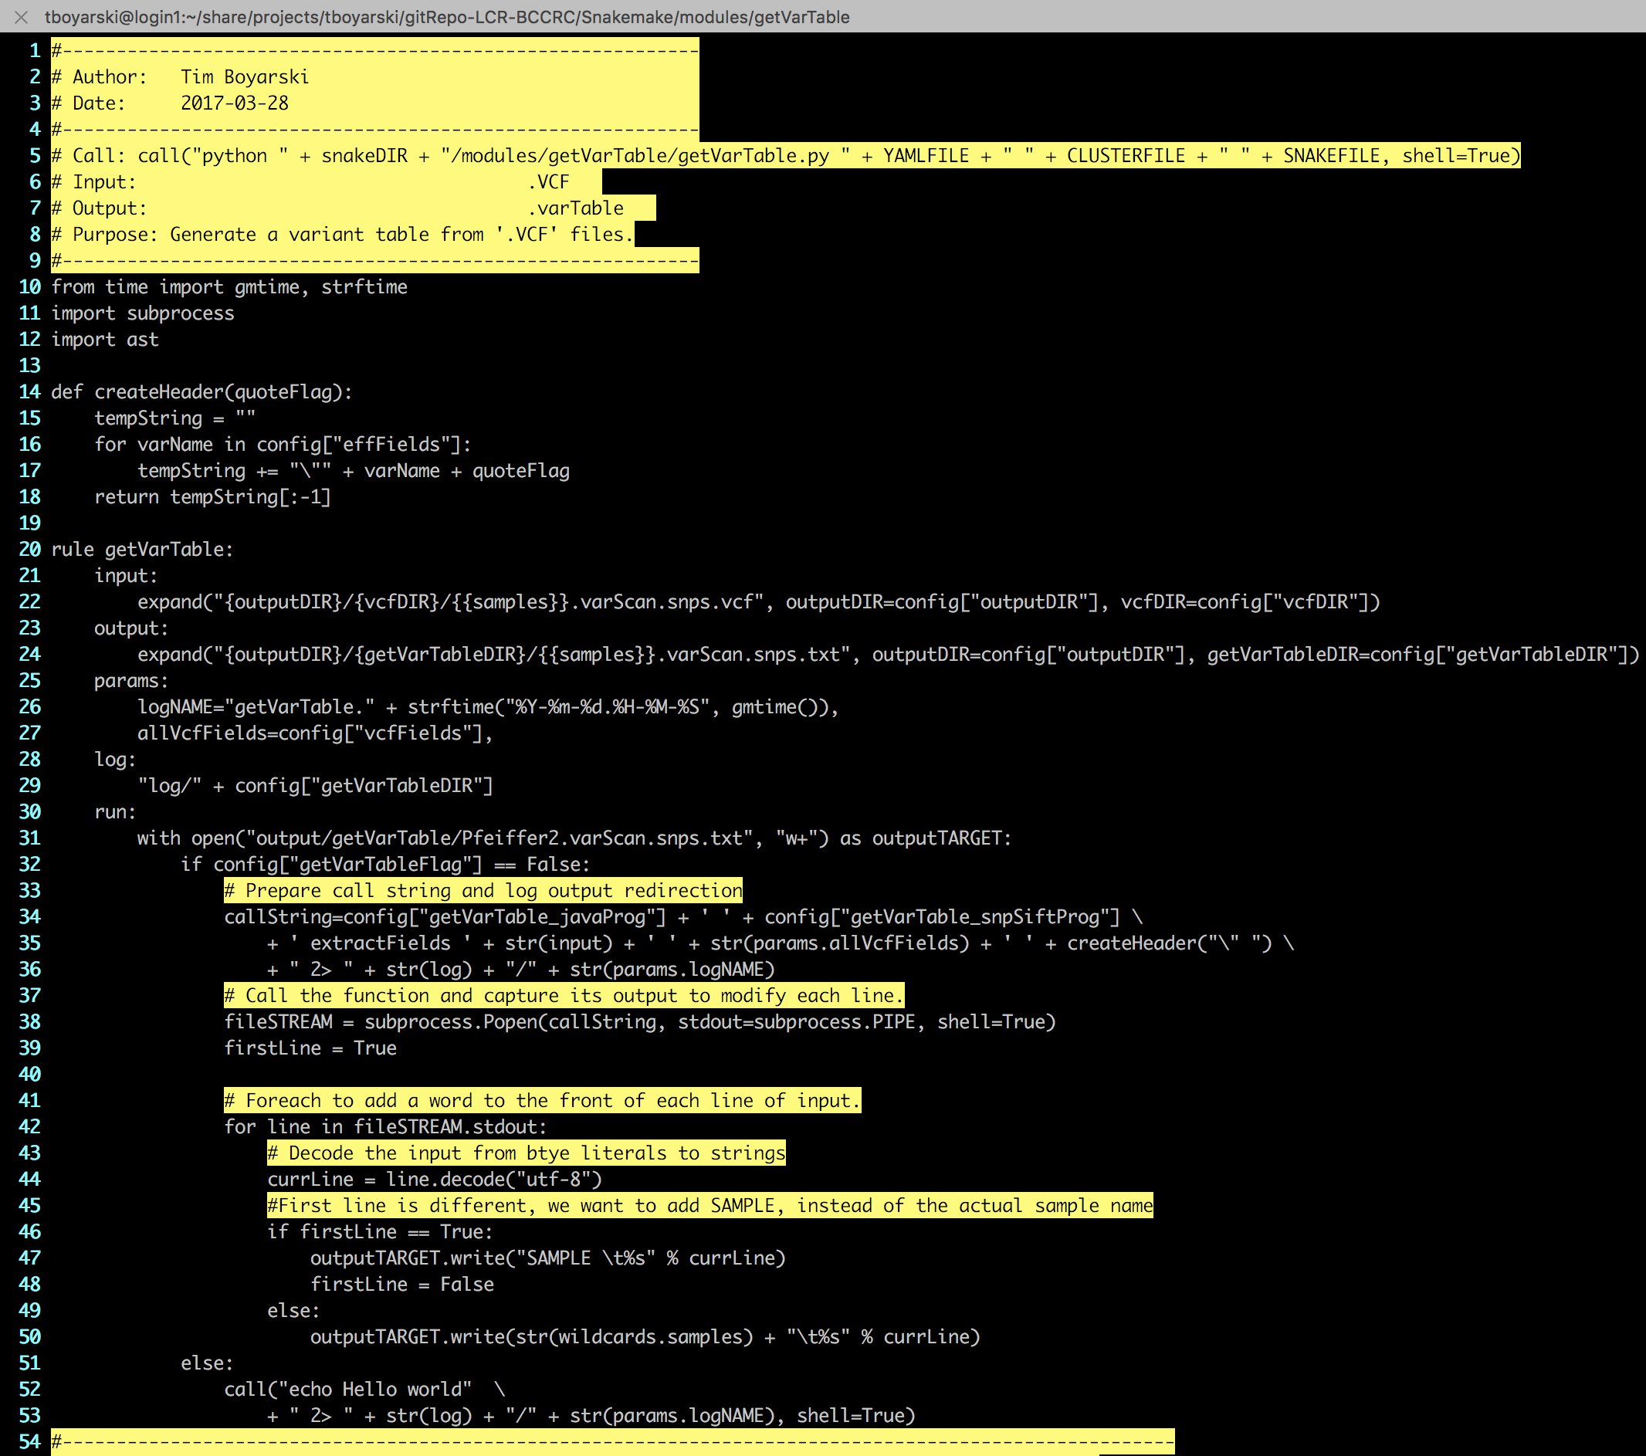
MARCH
translating…
150 characters

Slide 20
THEORY
Sequence
Present
Publish
Assemble
Process
MODULES
varScan
vcfTools
Samtools
MuTect
R Studio
BioBamBam
Platypus
ACTUAL
GSC
R Studio
Nature
Samtools
MuTect
Notes:
Explain modules
Assembly
The end goal, technically, would be a “ loosely-coupled factory” for pipeline generation.
In the remainder of my time, I’m going to try to build as many pieces as I can, such as to provide users with all the tools they need.
Additionally, moving forward I will also continue investigating environment management.
Any like any good factory owner, I need to manage my environment, you know political conditions, market conditions, etc..
It this case, it’s a digital environment, but the metaphorical equivalent would be like “zoning by-laws, provincial and federal laws, labour agreements, tax jurisdictions, insurance, payroll…”
The worrying just never stops.
End of presentation questions?

Slide 21
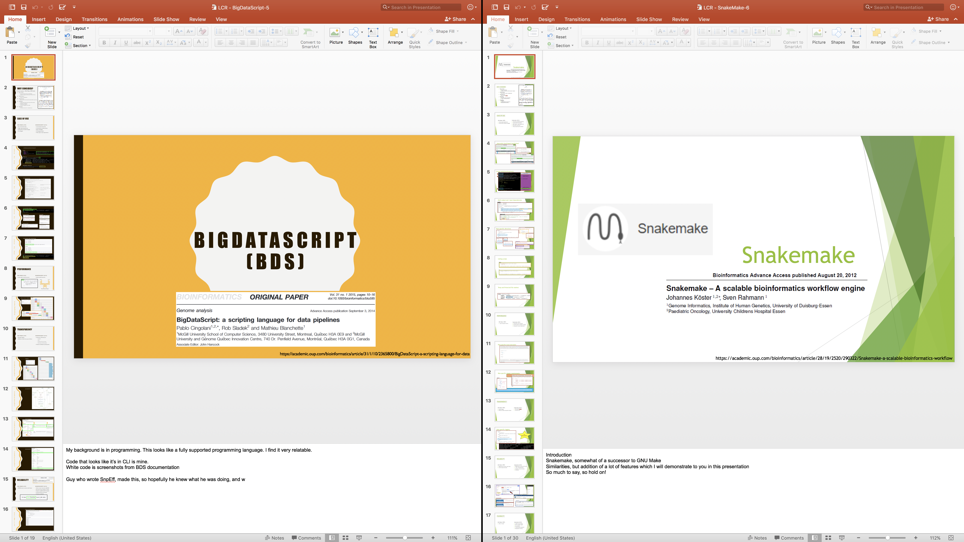
Notes:
20-30 Slides on each of the languages

Slide 22
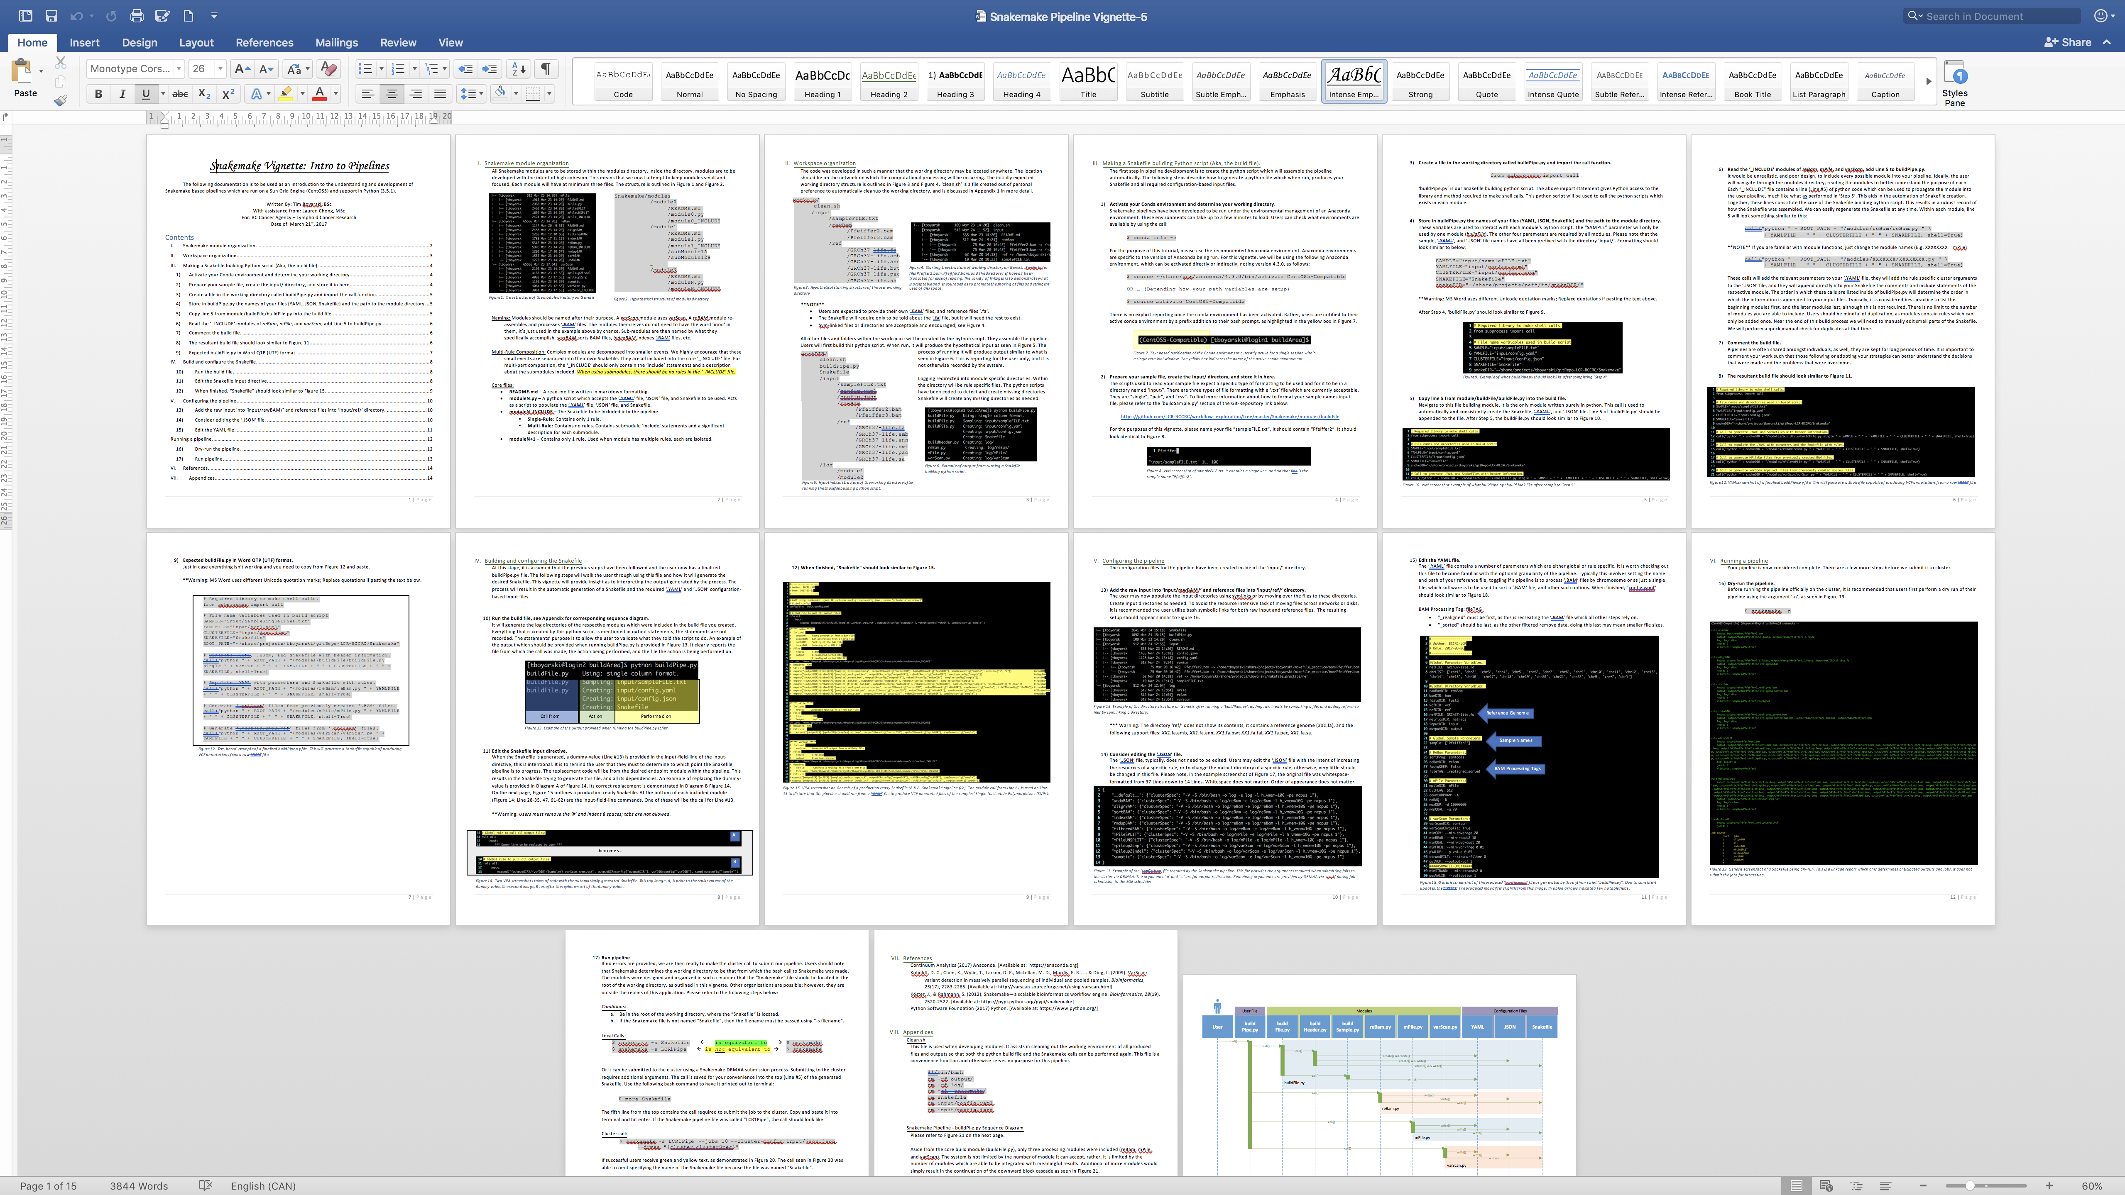
Notes:
Pipeline Vignette

Slide 23
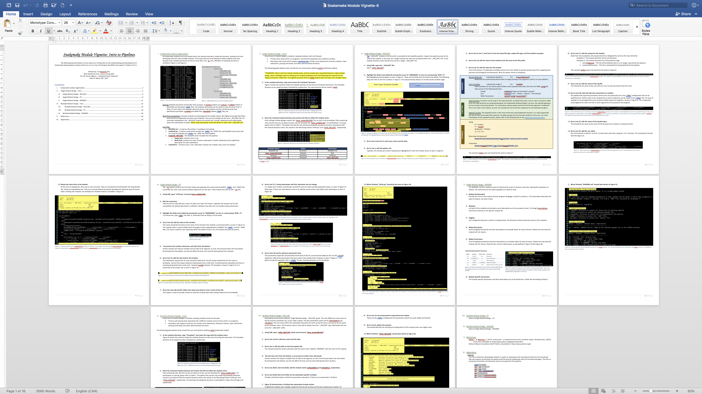
Notes:
Module Vignette

Slide 24
Questions?

